Slide 1
A Geospatial Introduction

Slide 2
Introduction
Location is central to health care
  Prices, practice patterns, prevalence
  It’s been said your zip code is one of the most important things about health status
Revolution in price and availability of geospatial tools
  Surprisingly functional basic capabilities are now in consumer software
    Excel, Google, and Tableau
Revolution in the availability of public use data
  Obama administration reversed the presumption that nothing is public unless we make an exception
  Widespread use of data publishing platforms such as Socrata so the public can see meaningful results, not just raw data
    And a bunch of NGOs are using those pubic sources to do useful mix-and-match
I’ll work through a local example in consumer tools and a regional example on government public use sites

Slide 3
A Local Example
Location is intrinsically important because every case has both a patient and a provider location
  Everybody lives someplace and every provider works someplace
  So you can calculate a distance and a transport time
  Accessibility and marketing both have lot to do with location
Patient aspects aren’t distributed randomly
  Zip code is a significant predictor with access and outcomes
HIPAA blocks talking about local cases, so I’m using a historical example

Slide 4
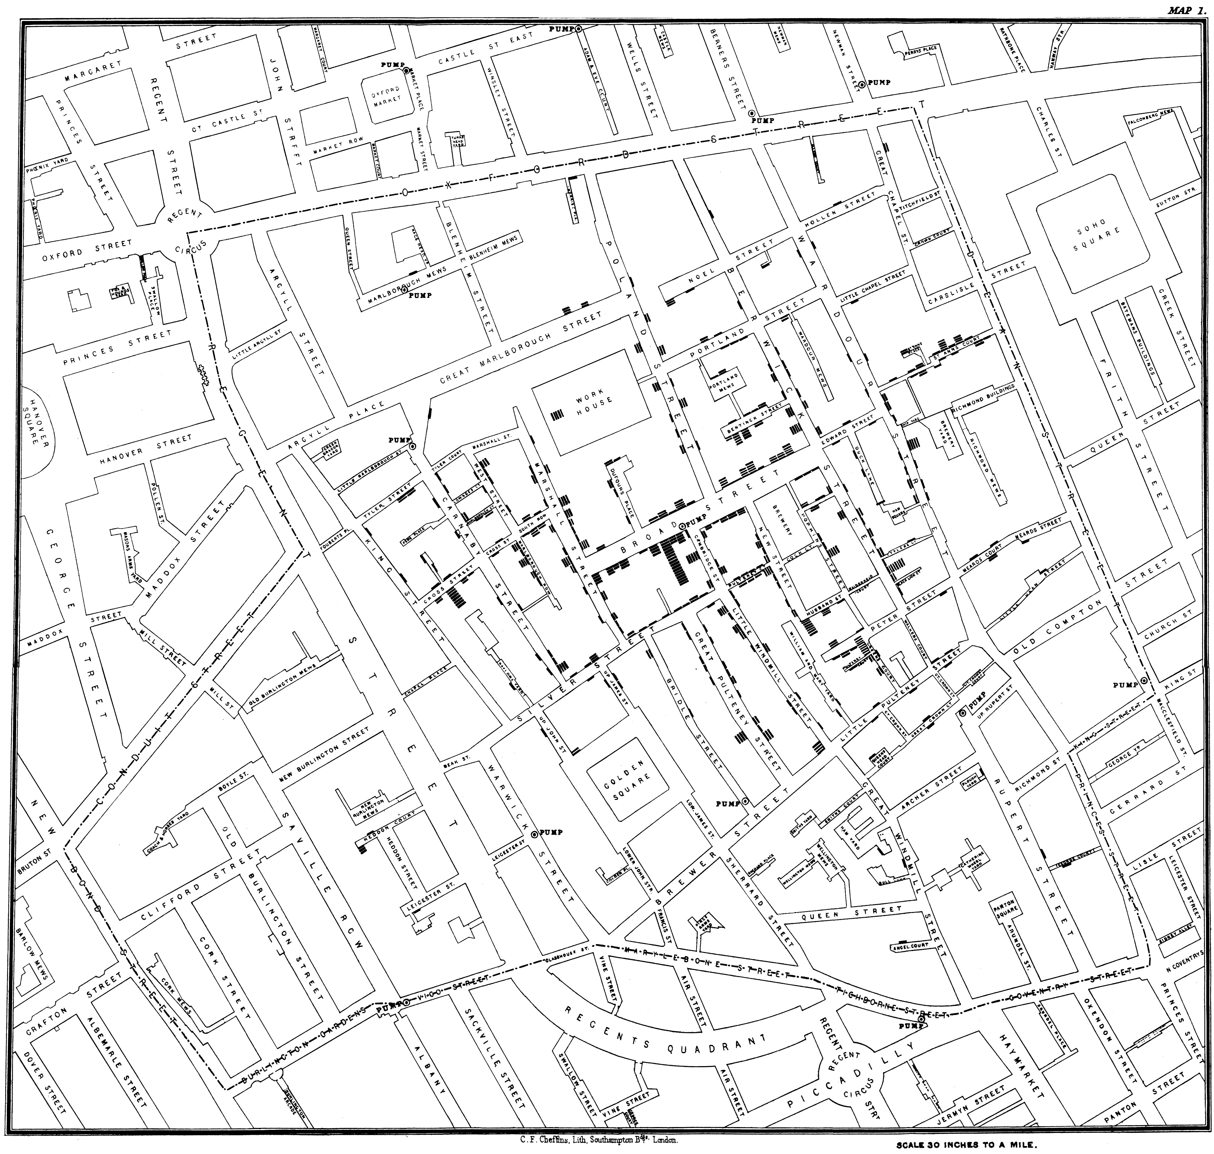
The Snow cholera map is really famous

Slide 5
It’d be a flaming privacy breach if current
Can figure out every patient’s address from their location
  Which would enable identifying them
Law hasn’t really caught up with mapping tools
  Only one clear safe harbor that talks about the first three digits of zip codes
    Which could be hundreds of thousands of people
  CDC won’t disclose on areas less than 100K and cells less than ten
Best practice is to geocode on-site or only do business with companies that will sign business associate agreements
  Which a lot will sign in exchange for money

Slide 6
Story is straightforward
Several hundred people died of cholera in London in the summer of 1854
Dr. John Snow collected data on how many people died at which address and produced a map
Turned out there was a water pump at the center of the deaths

Slide 7
To duplicate the map in a consumer tool
The bars on the map show the number of dead at particular addresses
The buildings are gone (London Soho now chic and expensive) but the streets are still there
Create latitude/longitude (latlong) pairs off the map and transform bars into integers

Slide 8
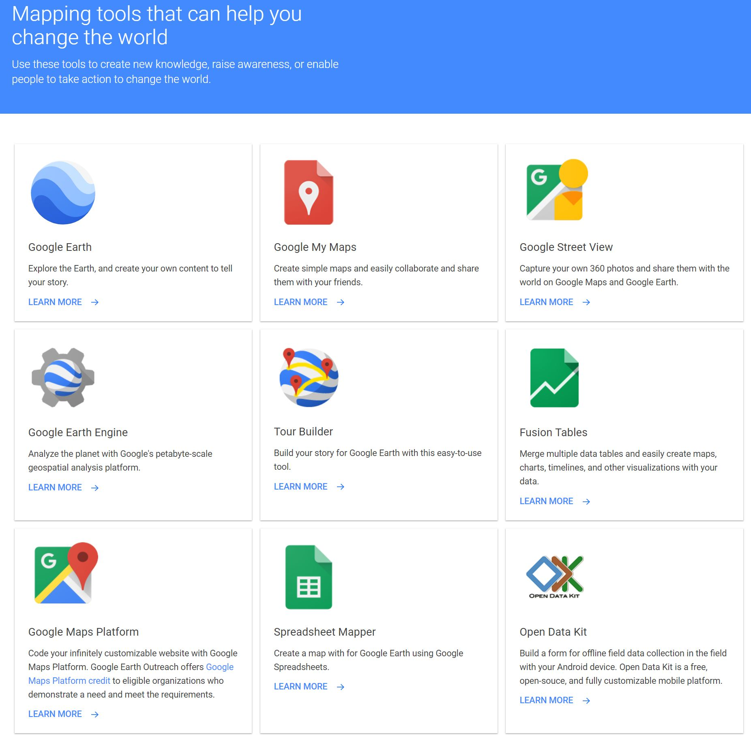
Google’s home page for consumer map tools

Slide 9
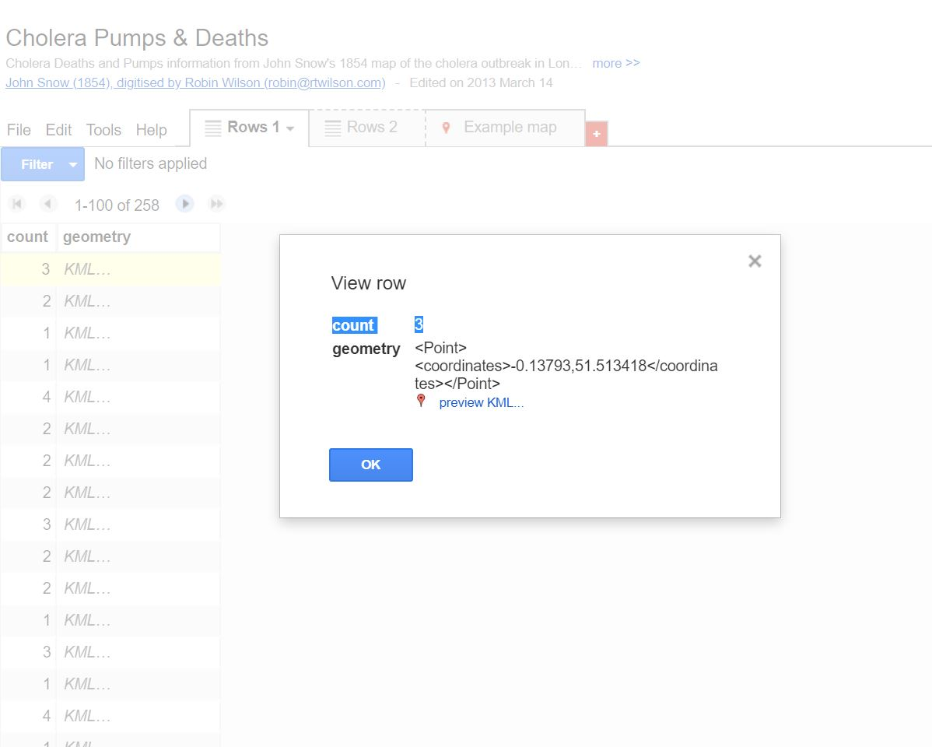
And here’s the latlongs of the buildings with the body count

Slide 10
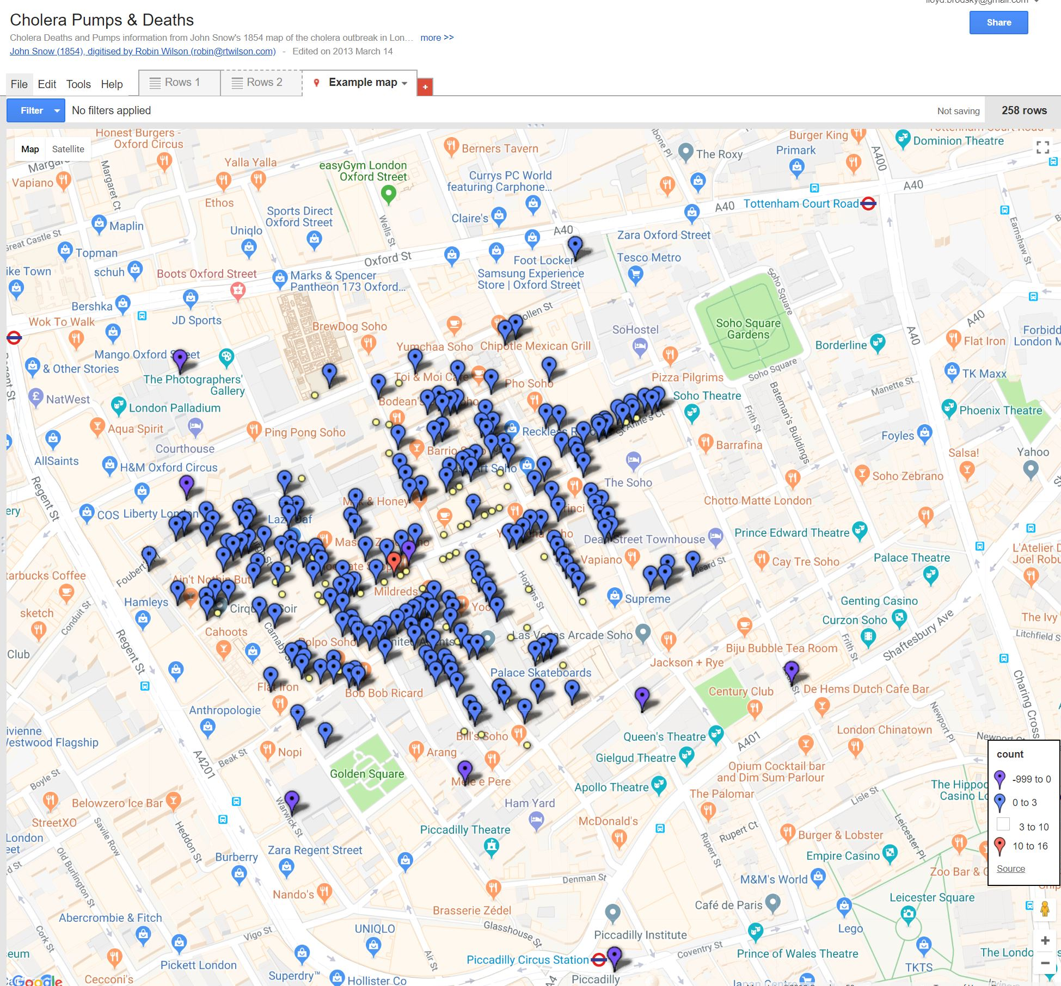
And here’s a Google map

Slide 11
Why is this so darned famous?
It’s a good story
Generally considered to be the first time geospatial analysis used in a public health context
Consistent with the utterly foundational germ theory of disease eight years before Pasteur and decades before Koch’s postulates
Two accidental double blind experiments
  Different addresses had different water providers serving different pumps due to the presence of a brewery in the impact area
  There was a brewery in the Broad street impact area. None of the brewery workers got sick – guess what they were drinking

Slide 12
With wonkier tools we can infer things from the location data
I’ll be using R, the statistical tool
To help guess if the pumps were important you want to draw pump-centered neighborhoods
  Voronoi tessellation does quick and dirty polygons based on generating points
  Shortest route calculation visualizes which pump has the shortest route for all addresses
Graph when the deaths happened
  Turns out the epidemic was petering out before pump handle removed

Slide 13
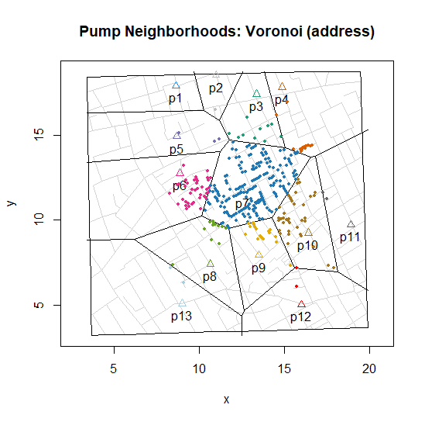
Voronoi neighborhoods based on pumps

Slide 14
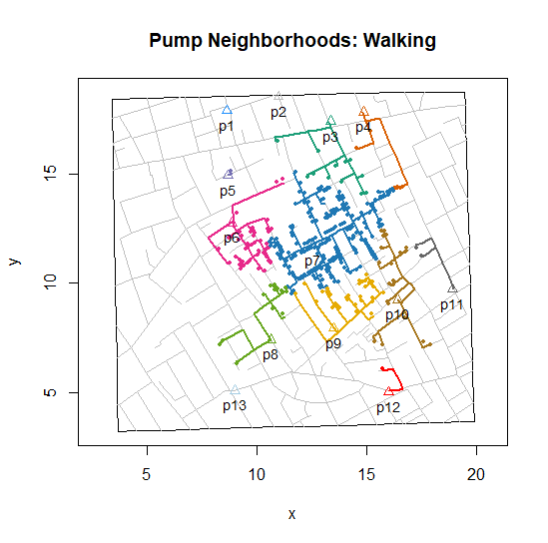
Pump neighborhoods based on shortest route

Slide 15
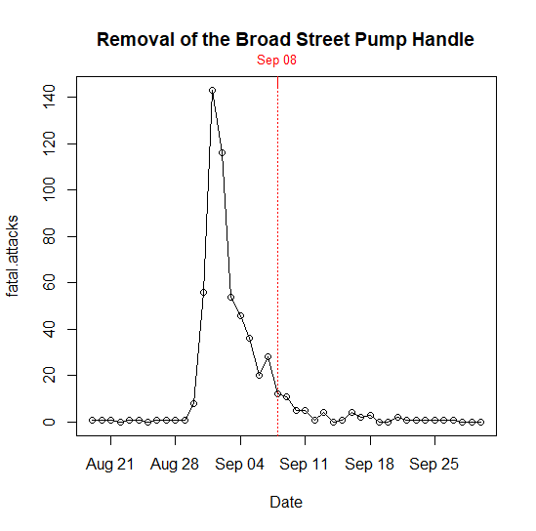
Deaths per day

Slide 16
Why should you care about maps now?
Epidemics aren’t the only reason to care about the spatial relationship between patients and
  Providers (distance is a big deal in selecting providers)
  Possible disease vectors
Very frequently people with the same vulnerabilities live near each other
  You’ll hear a lot of talk about “hotspots” in public health – people with the same social problems tend to leave in particular neighborhoods

Slide 17
You can easily make maps yourself
A map has several layers
  A base map you’ll get “free” from Google et al
  One for each table (usually at least two) of subject-specific locations you want mapped
    Such as deaths and pumps or patient and provider addresses
  One for each set of polygons defining areas such as states or counties
    Either built-in or get them from Census or the Dartmouth atlas
Add latitude and longitude columns using a geocoding service (consumer tools have one built-in)
Map it or do something summary if there’s a large number of points

Slide 18
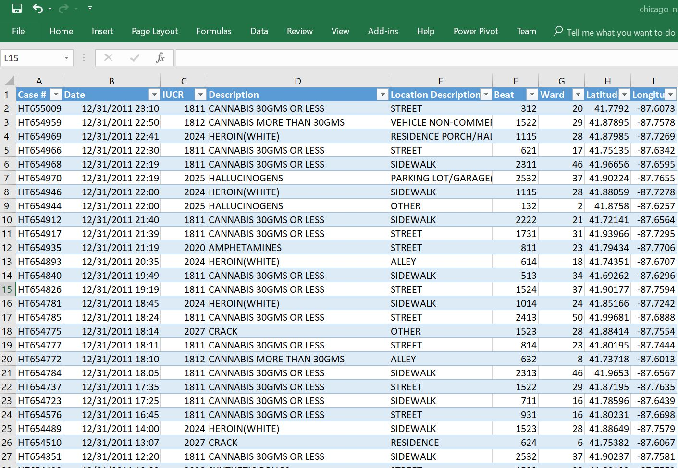
Here’s part of a Chicago drug busts table in Excel

Slide 19
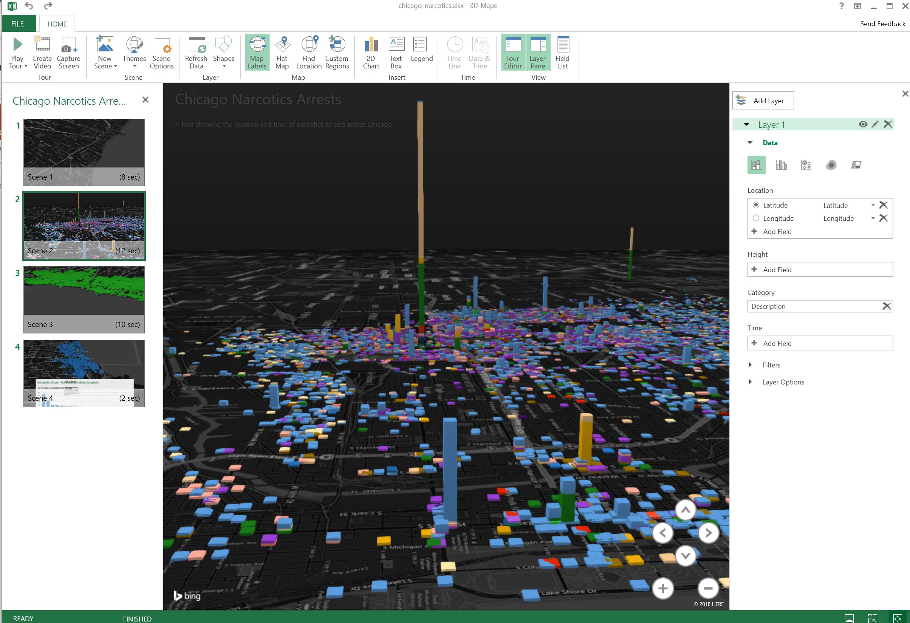
Here’s a stacked bar chart map by grid location

Slide 20
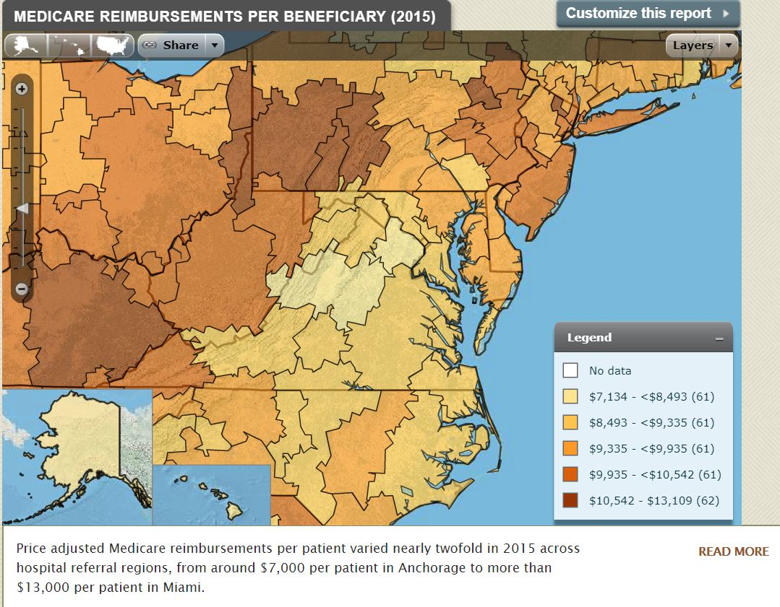
You can use Dartmouth atlas health regions for more business-related maps

Slide 21
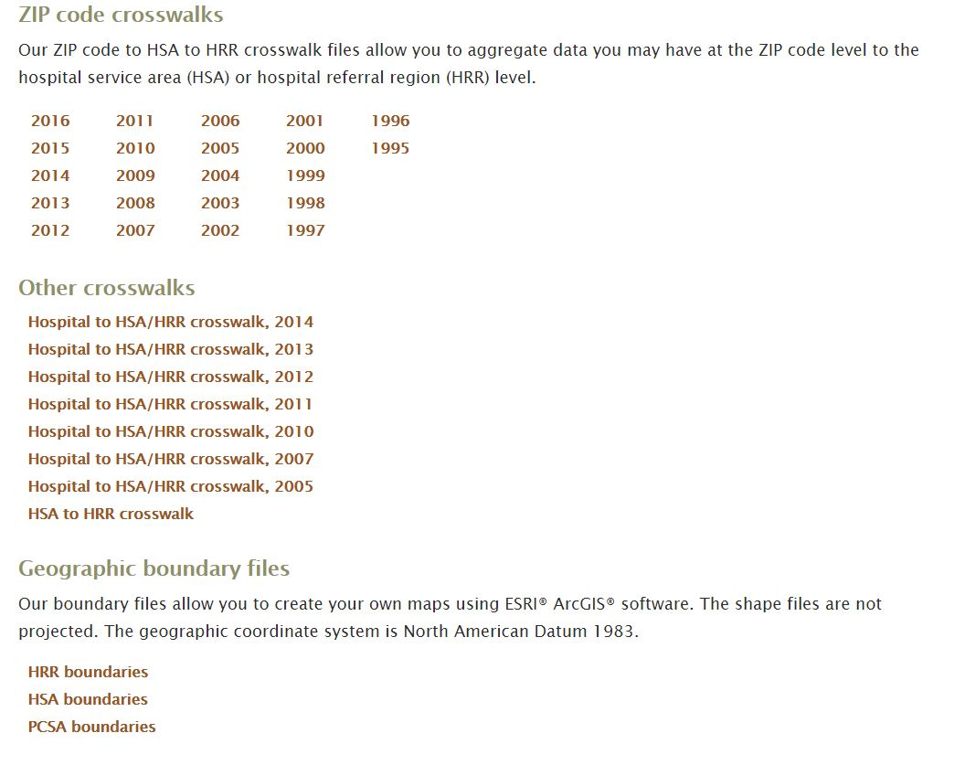
Dartmouth shapefiles and crosswalks

Slide 22
Moving on to public aggregated data
Only providers and insurance companies have individual case data
  Researchers can’t touch without an Institutional Review Board clearance
    And then you can’t publish any maps
So most research is done on pre-cleared aggregated data
The Case-Deaton “deaths of despair” paper used CDC, BLS, Census data published by county
  And Deaton won a Nobel prize so you should feel comfortable doing that too
I promised to talk about how to get data
So we’ll turn to opioids as an example

Slide 23
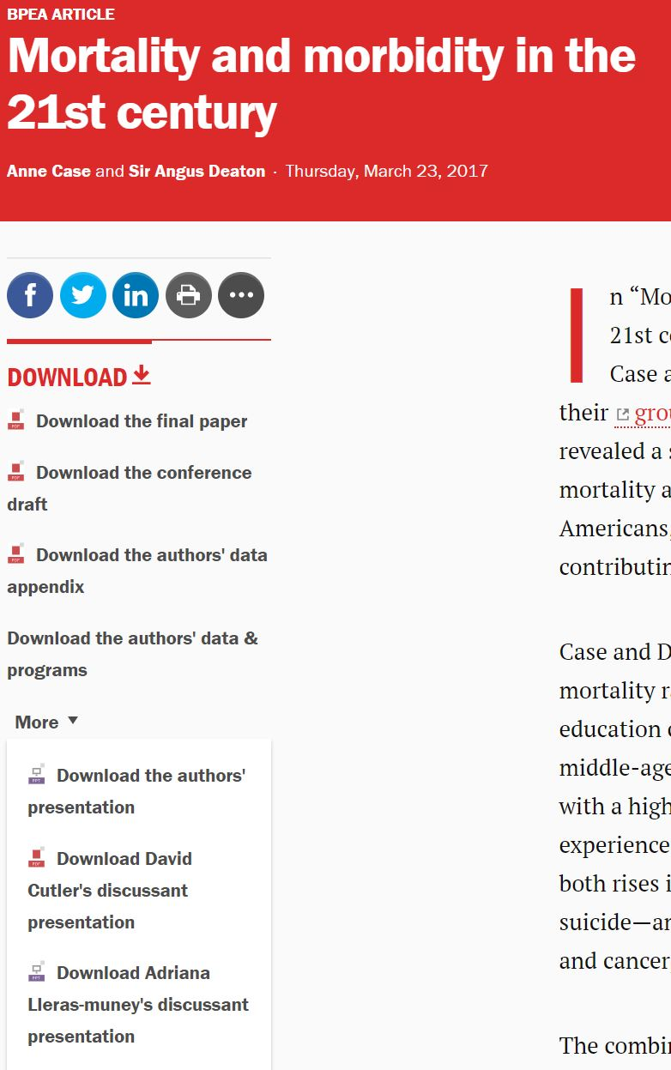
Papers often accompanied by data and code

Slide 24
Reasons why academic papers are often useful
If somebody already solved your problem, they’re giving away code and data, and it cleared peer review you’re done
It’s now the fashion to have data appendices that include data and sometimes code
  That can save you an awful lot of time in identifying sources and figuring out how to combine data
  If it’s a hit topic, there will be a follow-on boomlet of criticism “testing” the 80% of the work is gathering data from multiple sources
That’s actually how I found out the CDC had published data showing per capita consumption of opioids by county per year

Slide 25
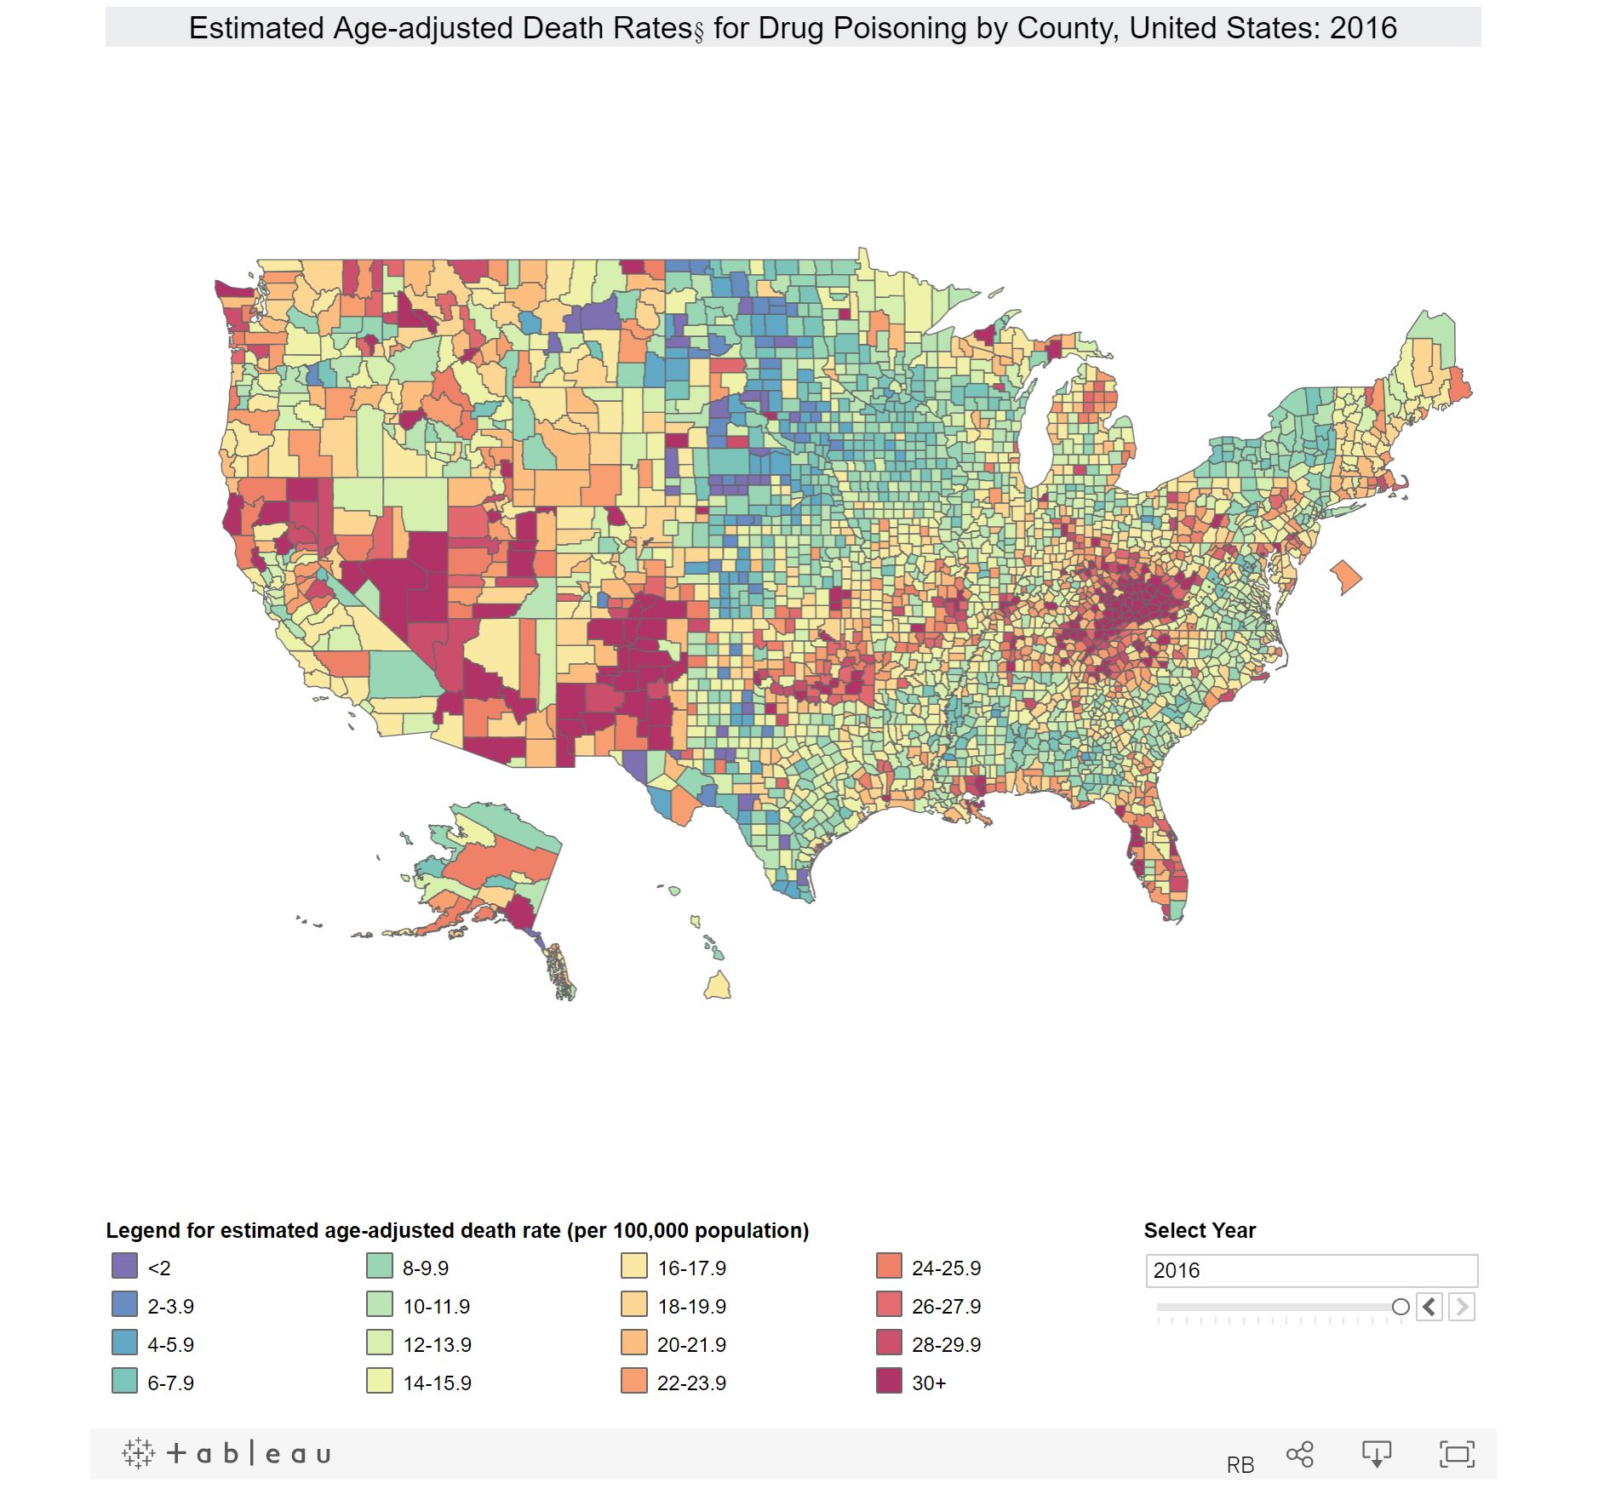
Moving to government -- this is from the CDC’s NCHS

Slide 26
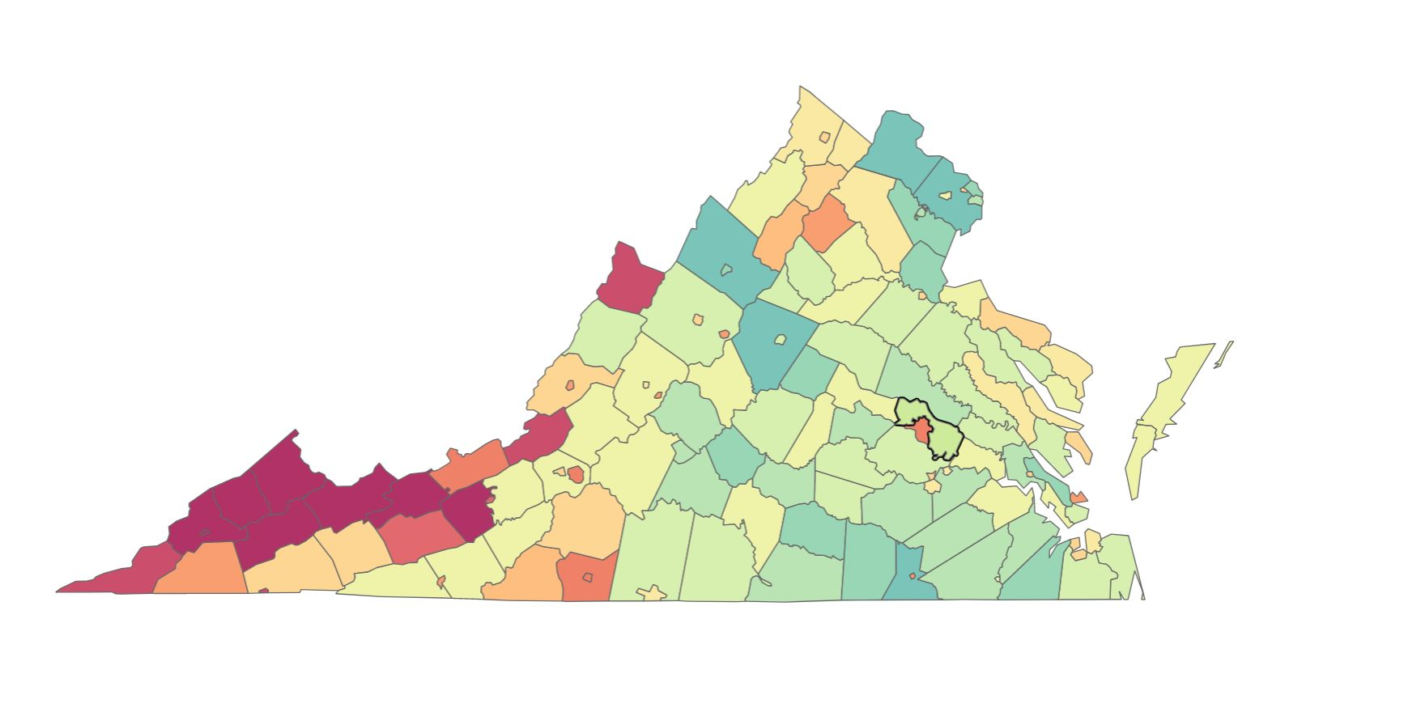
Zooming into Virginia

Slide 27
Zooming in further on Virginia
(VA gov website)

Slide 28
Explanation and gotchas
This is taken from the CDC’s National Center for Health Statistics’ Data Visualization gallery and the Virginia Dept of Health
  It’s age-adjusted drug poisoning rates by county
  Keep in mind all fill maps show one and only one measure, no matter how complicated the problem is
  Rate = number of age-adjusted deaths/population
  Most fill maps are have to do rates in fill maps because counties have different populations
    So you can’t tell that Fairfax has the highest number of deaths (much higher population but a lower rate)
  Both initiate from their websites with images on Tableau Public
  Both have a facility for downloading the information in Excel
  Drug poisoning is mostly opioids, but includes sleeping pills and all other drugs
    You almost never get exactly what you want with summarized data

Slide 29
Explanations and gotchas (2)
Note that Virginia is not replying on single measures and other measures give you different impressions
  You want a whole bunch to get a picture of what’s going on
NCHS gets its data from state vital statistics agencies
CDC generally has a very high standard for deidentifying data
  All the states needed to agree
An individual state can decide to release more data
  Some do, some don’t
Both the NCHS and Virginia run their own web site, but put the data on Tableau Public – an increasingly common choice
  There’s a button to download both data and image
SAMSHA has a different set of survey-based addiction data

Slide 30
Best web sites for geospatial health data
CDC Wonder https://wonder.cdc.gov/
  Acronym for Wide-ranging Online Data for Epidemiological Research
American Factfinder https://factfinder.census.gov
  Browses a number of Census data products including the preposterously useful American Community Survey, the source of most social determinants data
  I recommend using the advanced search option
  Census is the rare source with sub-county reports – zip codes, census tarcts and blocks
Census Maps and Data https://www.census.gov/geo/maps-data/
  The mother lode of shapefiles
http://www.dartmouthatlas.org/

Slide 31
Best web sites for geospatial health data
http://www.countyhealthrankings.org/
  Self-explanatory name. Preposterously useful assembling of data from multiple sources including a wide range of social determinants. From the RWJ Foundation
CMS Geographic Variation Public Use Files
  https://www.cms.gov/Research-Statistics-Data-and-Systems/Statistics-Trends-and-Reports/Medicare-Geographic-Variation/GV_PUF.html
  Medicare data
CMS Open Payments https://www.cms.gov/openpayments/
  Medicare payments to doctors and teaching hospitals. Socrata-based interactive data explorer and visualizer

Slide 32
Why should you care?
The price is right
If you’re not a provider or insco it may be the only location data you can get
The government has better statisticians than you do
You could never afford to run any of the large-scale surveys, even locally
It helps solve the “denominator problem” in many business intelligence systems
  You may know how many, say, births your hospital has. What percent of total births in the area is that? Ask Census or the local DoH

Slide 33
Conclusions
You should be asking how location affects your results – it probably does and you may not have been paying attention
You have free consumer-friendly map tools already – Excel, Google, and Tableau Public
  If you want something wonkier you have R and Qgis
Geospatial data freely available from relevant government agencies
  CMS for Medicare, CDC health statistics, Census for social determinants and shapefiles
Lot of that is prettily repacked by NGOs
  Dartmouth Atlas, countyhealthrankings.org

